Slide 1

APPLY AT EASE
CO-FOUNDERS : Venkatesh Velagapudi
Sowmya Potla
Nikhil Reddy Baireddy
Sahiti Uppu
Ram Dixit Erra

Slide 2

Trouble Spots.
1.Replications that demands lot of your time and efforts. present web applications are time consuming.
3. Referencing multiple platforms for where, what and how to learn and build career
4.Repeatative background verification each time
2.Not easy to connect end user to sources as there is need for rigorous search process to find the right profile and to start the conversation

Slide 3
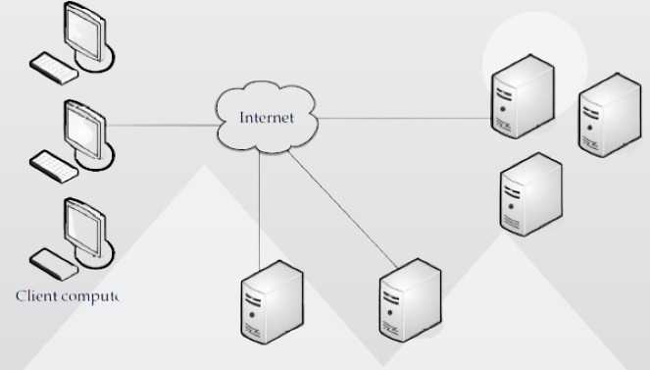
DC Concepts
Concurrency
Data Integration.
Scalability
Fault Tolerance
Heterogeneous

Slide 4

Drawing Solutions
Insights to solve the pain points:
Proposing courses and suggesting respective job opportunities depending on current market.
Saving time and efforts with a single go.
Maintaining thrift at background verification.

Slide 5

Limitations of Current Offers
Background verification is expensive procedure that incorporate lot of time.
Figuring out single platform to predict and get recommendation on job market depending on set of courses and educational institutes that a student prefers to choose.

Slide 6

Target Market and Analytics
Job Seekers and Providers
Students
Analytics on jobs and their market value

Slide 7
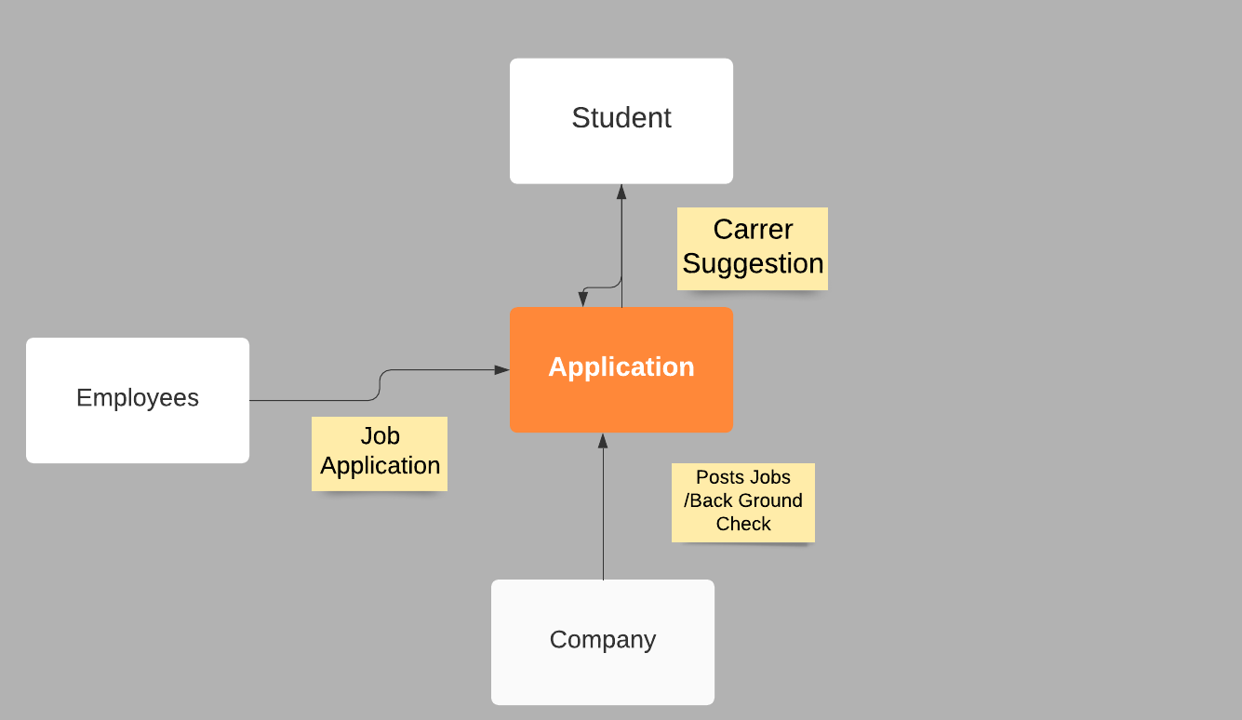
Business Flow

Slide 8
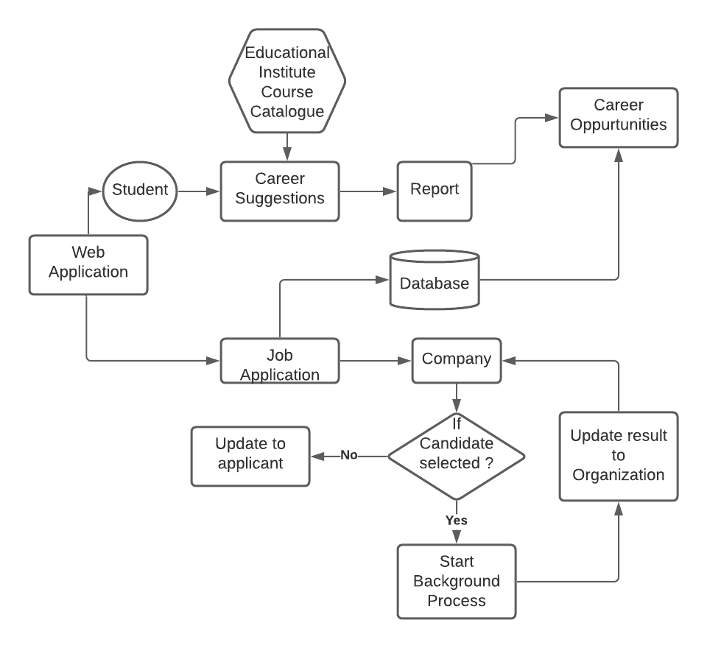
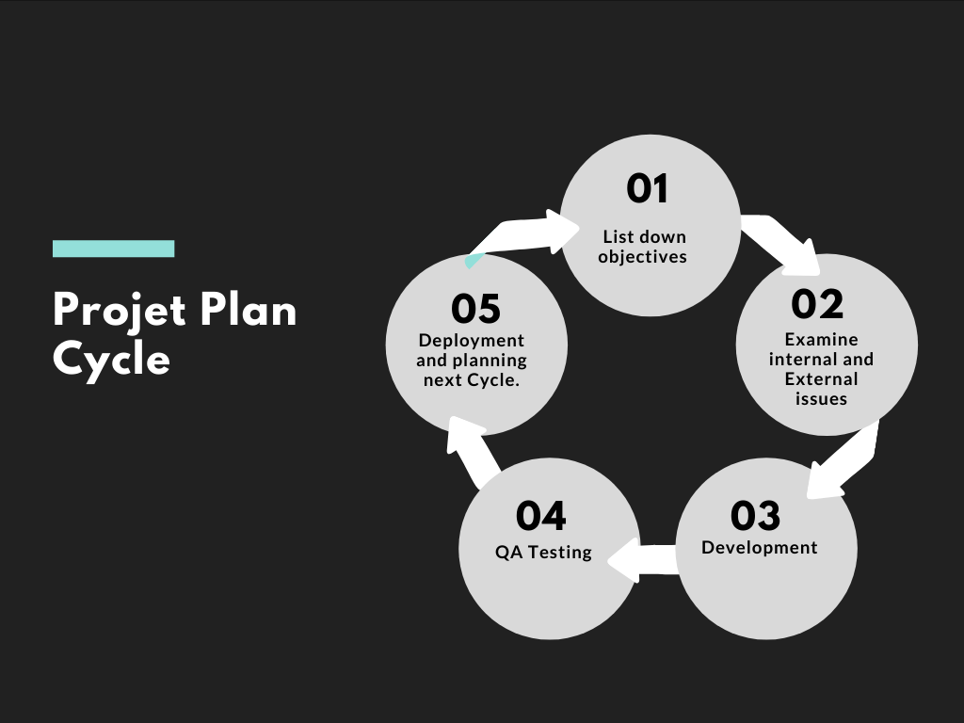
DESIGN AND PLAN

Slide 9

Team Members and Contribution
Venkatesh: Interaction Design and UI part
Sowmya P: API Part interaction with UI and Back End.
Sahiti U : Experienced in creating and handling Data base
Nikhil B: Navigation Part, documentation and Architecture.
Ram Dixit: Framework and Devops.

Slide 10

Technologies Used in Project
Methodology
Agile Methodology.
Defect Reporting
Salesforce Chatters.
Communications
Microsoft Teams, Outlook.
Development
Heroku, Angular 9, Java 16 JDK, SQL, REST API, SOQL, HTTP Salesforce, Python, HTML, CSS, Angular Material.
IDE and Version Control
GitHub and visual studio code.

Slide 11

Thank You!

